Slide 1

IP Log Rate Limiter
Full-stack security application combining rate-limiting controls with comprehensive IP logging using Node.js, Express, and MySQL

Slide 2

Project Objectives
Block Brute-Force Attacks
Control User Actions
Prevent unauthorized login attempts through intelligent rate limiting
Stop button spamming and chat flooding behaviors
Track IP Activity
Persistent Logging
Monitor and log every user action with full IP attribution
Store comprehensive activity logs in MySQL for analysis

Slide 3
Technology Stack
Core Technologies
Development Tools
VS Code for development
Frontend Layer
GitHub for version control
HTML5, CSS3, JavaScript
Postman for API testing
ChatGPT for documentation support
Backend Layer
Project Structure
Node.js, Express.js
project/├── backend/│ └── AI.js└── frontend/ └── AI.html
Database
MySQL2

Slide 4




System Architecture
User Interface
Rate Limiters
IP Logs Table
Frontend interaction layer
Backend validation logic
MySQL storage
Three specialized limiters protect login, button clicks, and chat submissions. Backend validates requests, applies rate limits, and logs all activity with IP addresses and timestamps to MySQL database.

Slide 5

Rate Limiting Strategy
01
02
03
Login Limiter
Button Click Limiter
Chat Message Limiter
Controls authentication attempts to prevent credential stuffing
Prevents automated bot interactions and spam clicking
Stops message flooding and maintains conversation quality

Slide 6
Key Features
1
Real-Time Protection
Instant rate limiting validation on every request
2
Three-Tier Control
Separate limiters for login, click, and chat actions
3
Temporary Blocking
Automatic IP blocking after threshold exceeded
4
Complete Activity Logging
Every action logged with IP, timestamp, and status
5
Testing Interface
Built-in UI for validating limiter functionality
6
Secure Backend
Protected logic with no internal exposure

Slide 7
Implementation Workflow
Request Received
1
Frontend sends action to backend
2
IP Extraction
System identifies client IP address
Rate Check
3
Validates against limiter thresholds
4
Action Taken
Allows or blocks based on limits
Database Log
5
Records activity in MySQL ip_logs table

Slide 8

Database Schema
ip_logs Table Structure
Field
Type
Description
id
INT
Primary key
ip_address
VARCHAR
Client IP address
action_type
VARCHAR
Login/Button/Chat
timestamp
DATETIME
Action time
status
VARCHAR
Allowed/Blocked
Persistent logging enables security audits, pattern analysis, and compliance tracking

Slide 9
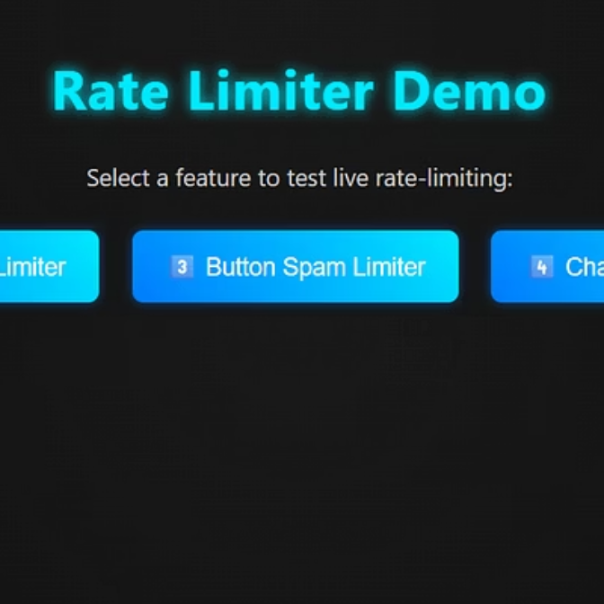
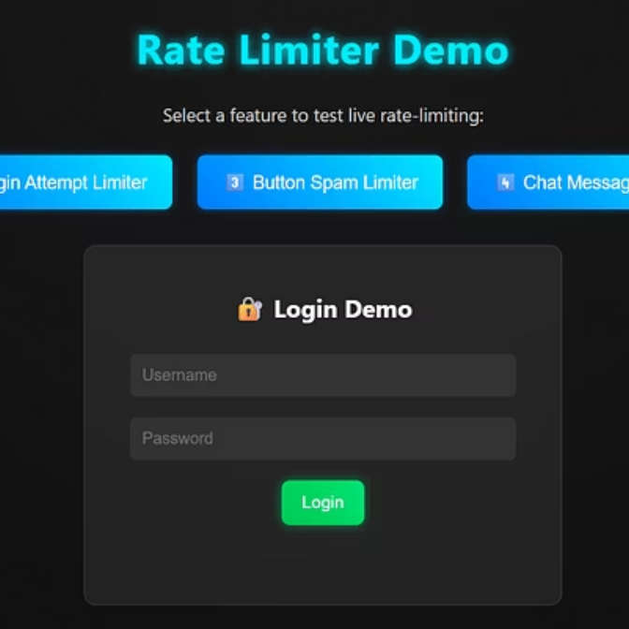
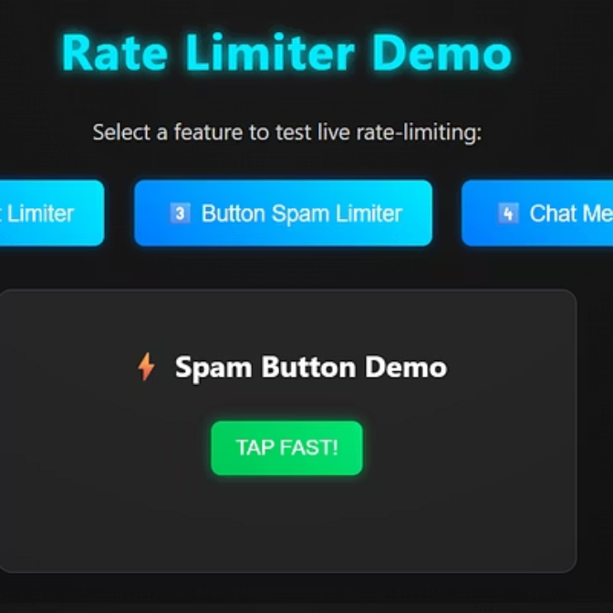
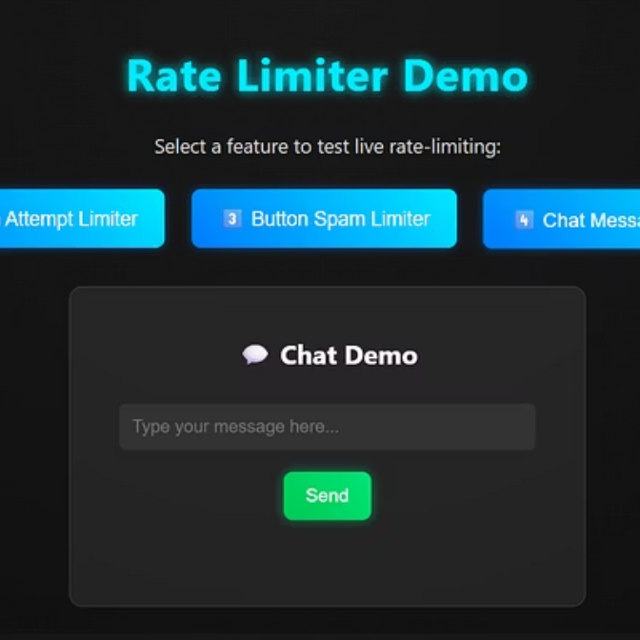
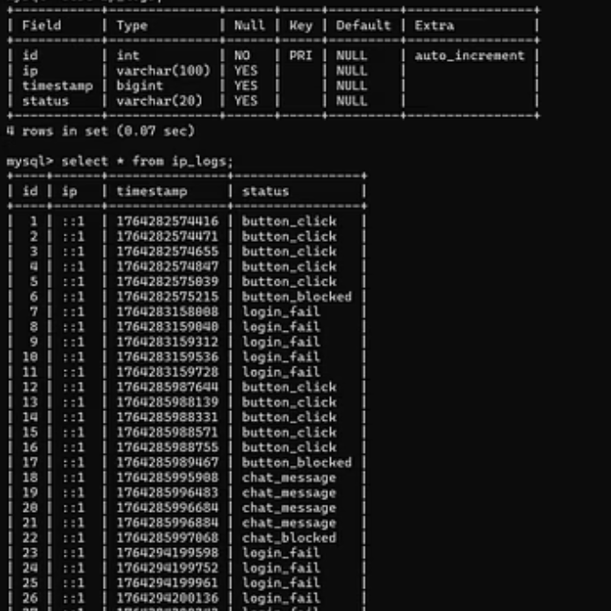
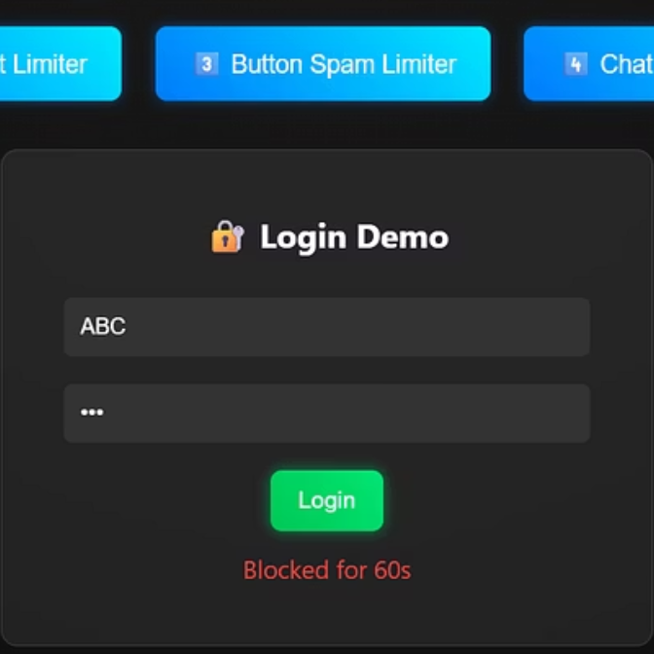
Live Demo Interface
This section showcases the working demonstration of the rate limiting system through various uploaded screenshots.
These screenshots demonstrate the complete functionality of the rate limiting system in action, from the main interface and various demo features to database logs and blocked attempts, showcasing its effectiveness.

Slide 10

Development Team
1
2
PADALA KRISHNA CHAITHANYA GOUD
Sri Charan
Roll No: 2403A52214
Roll No: 2403A52213
3
Abyudh S
Roll No: 2403A52215
Thank You
Questions & Answers

